Slide 1
REAL-TIME PHISHING URL DETECTION USING ML AND DL
NAME : Shaikh Shamsuddin Mohiuddin
SEAT NO : 3010205
COURSE : T.Y.I.T

Slide 2
Introduction
Phishing is a cyber-attack where fake websites trick users into giving sensitive information.
Daily thousands of users lose their data and money due to such attacks.
This project aims to detect such phishing URLs in real-time using Machine Learning and Deep Learning.
It not only analyzes the URL structure but also user interaction and site behavior

Slide 3
Objectives
Detect phishing URLs in real-time with high accuracy.
Analyze behavioral patterns such as redirects, form triggers, SSL info, etc.
Train machine learning and deep learning models for intelligent prediction.
Warn users instantly before they access suspicious or harmful links.

Slide 4
Methodology
Dataset Collection : Collect phishing and legitimate URLs from sources like PhishTank, Kaggle.
Feature Extraction: Analyse structure — length, symbols, IP usage, domain age, etc.
Model Training: Use ML and DL algorithms to classify URLs as phishing or safe.
Real-Time Detection: User inputs URL → Prediction → Alert system

Slide 5
Tools & Technology
1 Frontend:
HTML, CSS, JavaScript
2 Backend:
Python Flask Framework
Machine Learning(Random Forest, Logistic Regression , Classification)
Deep Learning (TensorFlow, XGBoost, CatBoost)
Database (MySQL)
3 Tools & Libraries:
Scikit-learn, TensorFlow/ Keras, Pandas, NumPy, Matplotlib, Seaborn
Anaconda /Jupyter Notebook

Slide 6
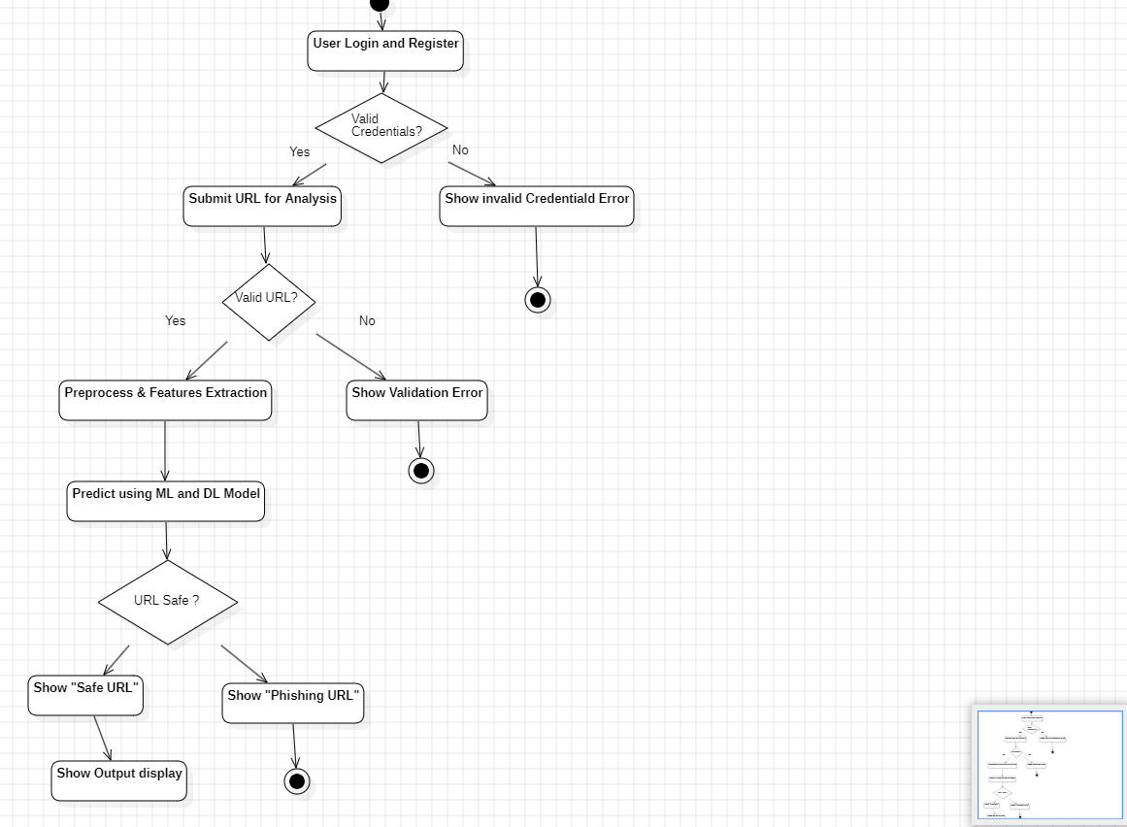
Flow Chart diagram

Slide 7
advantage
Real-time Detection
Behavioural Analysis
Automatic Feature Extraction
Self-Improving System
AI-Powered Accuracy
Preventive Security Measure
User-Friendly Interface

Slide 8
Existing Problem
Problem Statement: Phishing attacks have become one of the most common cybersecurity threats. Hackers create fake websites and URLs to steal user credentials, banking details, and personal information.
Traditional security systems fail to detect newly generated phishing URLs in real-time.
Existing Systems Issues:
Depend only on blacklisted URLs (limited database)
Cannot detect new or dynamically generated phishing links
Lack behavioral analysis and AI-based detection

Slide 9
Expected Outcome
97% phishing detection accuracy
A real-time web interface to test any URL
Visual analytics: risk level chart, confusion matrix
Live alert system for suspicious links
Complete project ready with code, UI, and documentation

Slide 10
Conclusion and Future Enhancement
Conclusion: The project effectively detects phishing URLs using AI-based models and helps reduce online fraud. It provides accurate, fast, and automated URL classification.
Future Enhancements:
Add browser extension for live URL scanning
Support for mobile application integration
Multilingual phishing site detection
Real-time user alert system
Progress for Security in dark Web fraud

Slide 11
References
1. Abu-Nimeh, T., Nappa, D., Wang, X., & Nair, S. — A comparison of machine learning techniques for phishing detection. (eCrime / ACM)
Retrived from : https://dl.acm.org/doi/10.1145/1299015.1299021
2. Xiang, G., Hong, J., Rosemblat, G., & Cranor, L. — CANTINA+: A feature-rich ML framework for detecting phishing web sites. (TSEC/ACM).
Retrived from : https://dl.acm.org/doi/10.1145/2019599.2019606
3. Ma, J., Saul, L. K., Savage, S., & Voelker, G. M. — Beyond Blacklists: Learning to detect malicious web sites from suspicious URLs. (KDD 2009)
Retrived from : https://cseweb.ucsd.edu/~jtma/papers/beyondbl-kdd2009.pdf
4. Sahingoz, O. K., Buber, E., Demir, O., & Diri, B. — Machine learning based phishing detection from URLs. Expert Systems With Applications (2019)
Retrived from: https://www.sciencedirect.com/science/article/abs/pii/S0957417418306067

Slide 12
Thanks for Your Attention!

